Slide 1
Manipulating Heaps
CLRS Chapter 6.1 – 6.3

Slide 2
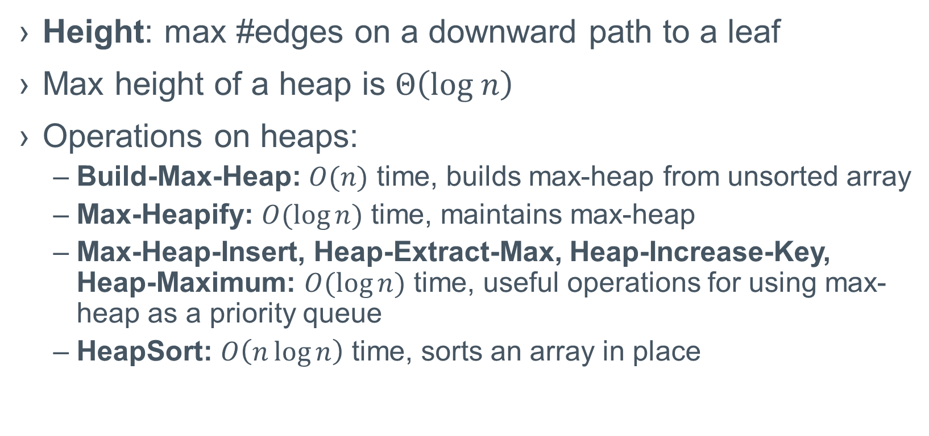
Max-Heaps and operations on them
Height: max #edges on a downward path to a leaf
Max height of a heap is $Θ\left(log n\right)$
Operations on heaps:
Build-Max-Heap: $O(n)$ time, builds max-heap from unsorted array
Max-Heapify: $O(\log{n})$ time, maintains max-heap
Max-Heap-Insert, Heap-Extract-Max, Heap-Increase-Key, Heap-Maximum: $O(\log{n})$ time, useful operations for using max-heap as a priority queue
HeapSort: $O\left(n\log{n}\right)$ time, sorts an array in place

Slide 3
Max-Heapify (aka Sift Down)
A.heap-size = current # keys in the heap
A.length = length of array used to store the heap
Objective of Max-Heapify:
Given an index i in an array
Assume left and and right subtrees are max-heaps
Max-Heapify ensures that subtree rooted at i is a max-heap

Slide 4
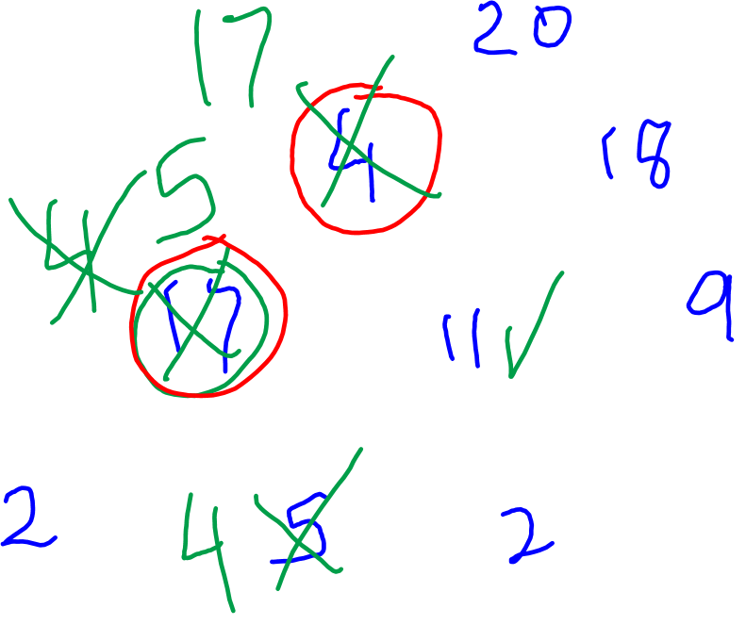
Max-Heapify Example

Slide 5
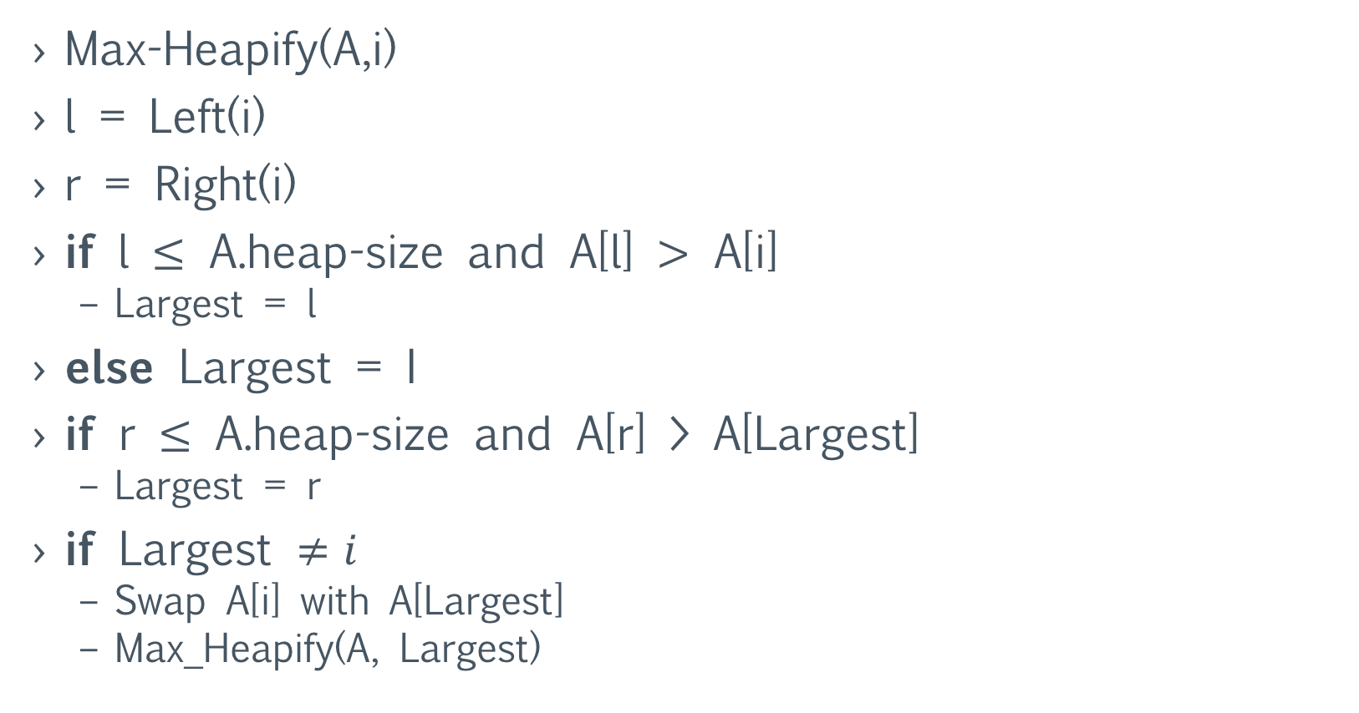

Max-Heapify (aka Sift Down)
Max-Heapify(A,i)
l = Left(i)
r = Right(i)
if l $≤$ A.heap-size and A[l] $>$ A[i]
Largest = l
else Largest = I
if r $≤$ A.heap-size and A[r] > A[Largest]
Largest = r
if Largest $≠i$
Swap A[i] with A[Largest]
Max_Heapify(A, Largest)

Slide 6
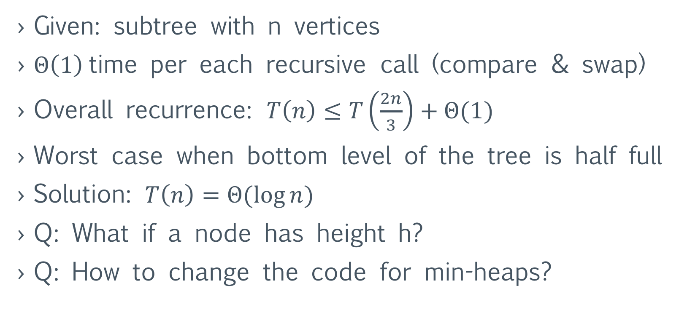
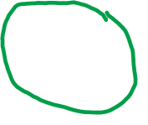
Max-Heapify: Runtime analysis
Given: subtree with n vertices
$Θ\left(1\right)$ time per each recursive call (compare & swap)
Overall recurrence: $T\left(n\right)≤T\left(\frac{2n}{3}\right)+Θ(1)$
Worst case when bottom level of the tree is half full
Solution: $T\left(n\right)=Θ(\log{n})$
Q: What if a node has height h?
Q: How to change the code for min-heaps?

Slide 7
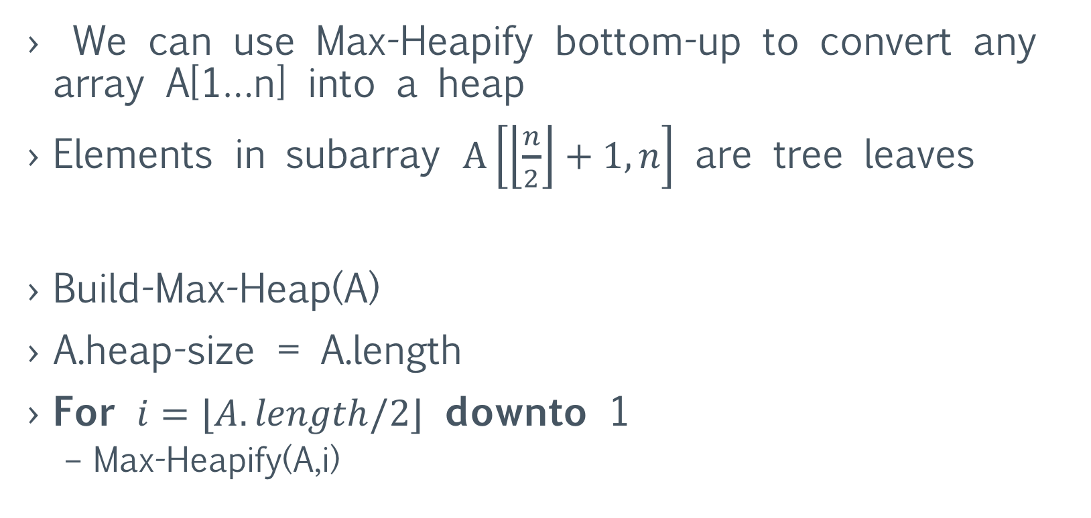
Building a Heap
We can use Max-Heapify bottom-up to convert any array A[1…n] into a heap
Elements in subarray $A\left[\left\lfloor \frac{n}{2}\right\rfloor +1, n\right]$ are tree leaves
Build-Max-Heap(A)
A.heap-size = A.length
For $i=⌊A.length/2⌋$ downto 1
Max-Heapify(A,i)

Slide 8
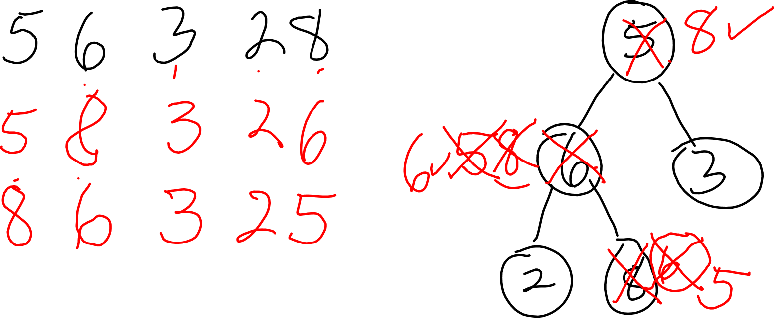

Slide 9
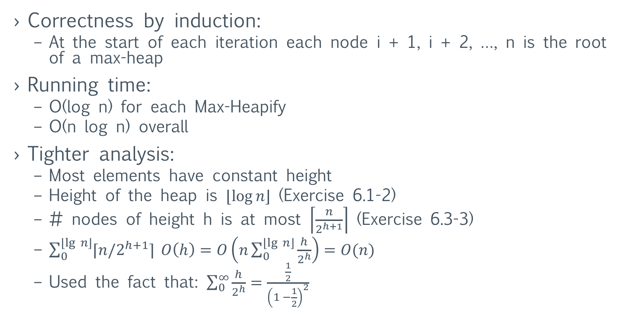
Building a Heap: Correctness and Time
Correctness by induction:
At the start of each iteration each node i + 1, i + 2, …, n is the root of a max-heap
Running time:
O(log n) for each Max-Heapify
O(n log n) overall
Tighter analysis:
Most elements have constant height
Height of the heap is $⌊\log{n}⌋$ (Exercise 6.1-2)
# nodes of height h is at most $\left\lceil \frac{n}{2^{h+1}}\right\rceil$ (Exercise 6.3-3)
$\sum_{0}^{⌊\lg{n⌋}}{⌈n/2^{h+1}⌉} O\left(h\right)=O\left(n\sum_{0}^{⌊\lg{n⌋}}{\frac{h}{2^{h}}}\right)=O(n)$
Used the fact that: $\sum_{0}^{∞}{\frac{h}{2^{h}}=\frac{\frac{1}{2}}{{\left(1 −\frac{1}{2}\right)}^{2}}}$

